Slide 1
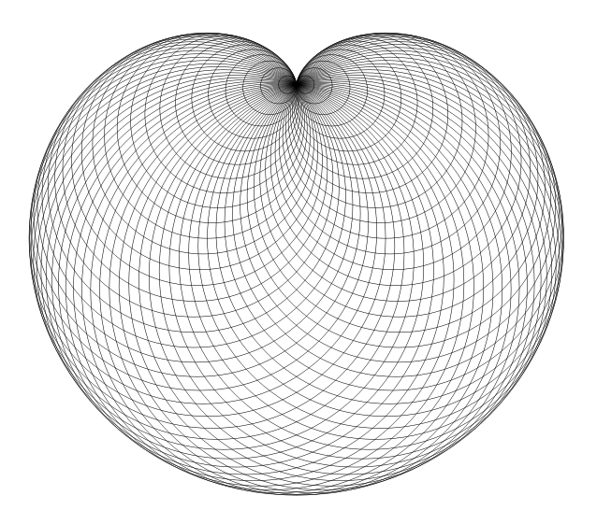
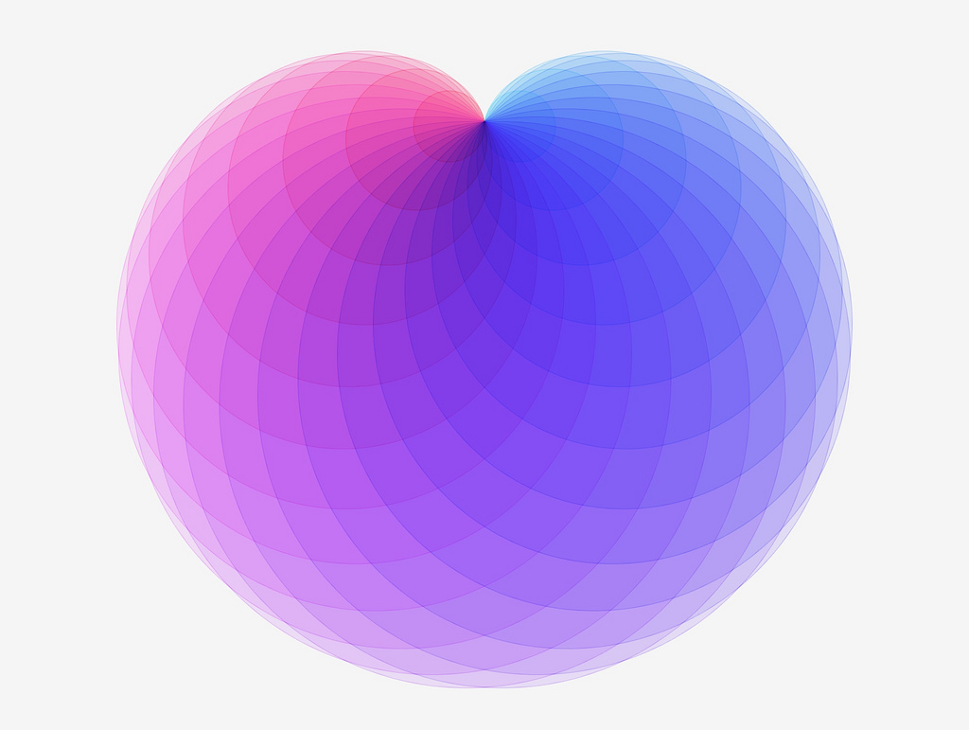
Drawing a cardioid
Cardioid curve given as an envelope of circles. Author: RDBury
Notes:
Font: Arial Rounded MT Bold

Slide 2
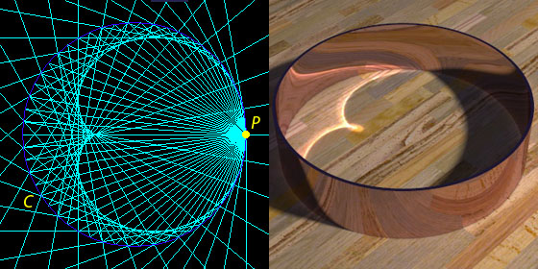

Slide 3
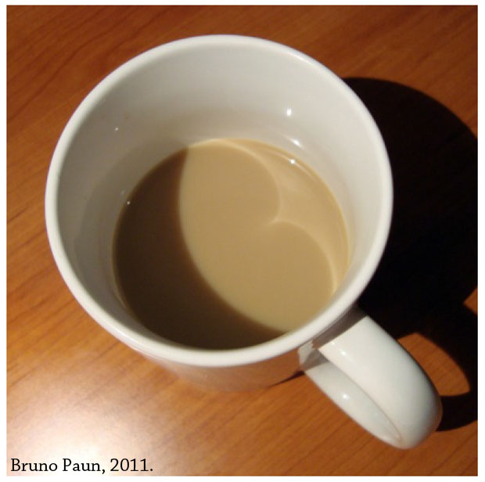

Slide 4
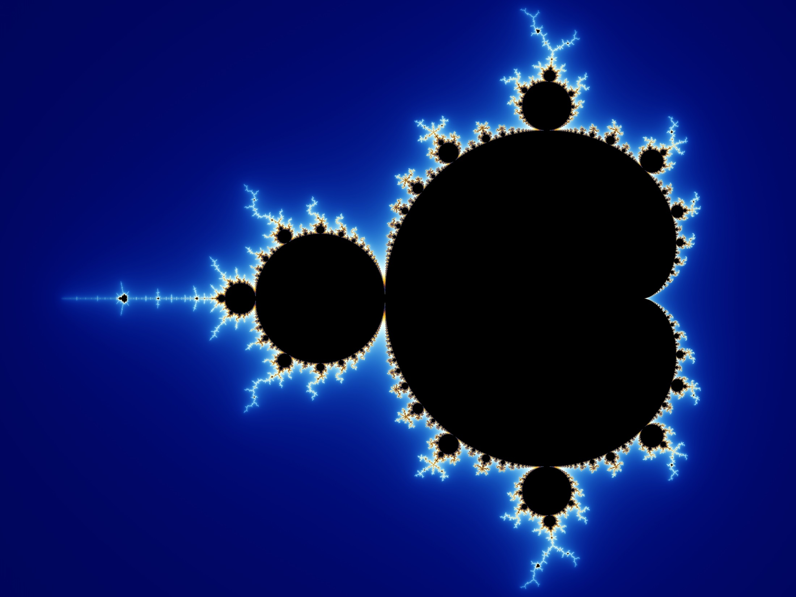

Slide 5
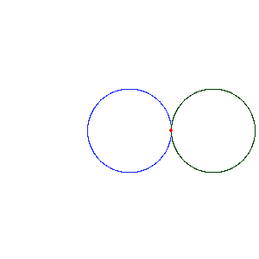
Cardioid gif. Author: Wojciech Swiderski

Slide 6
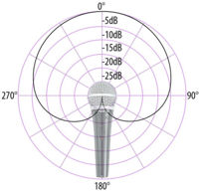
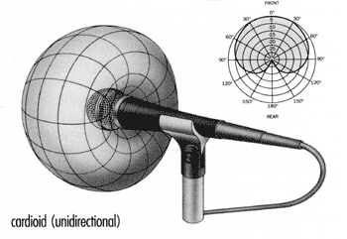

Slide 7
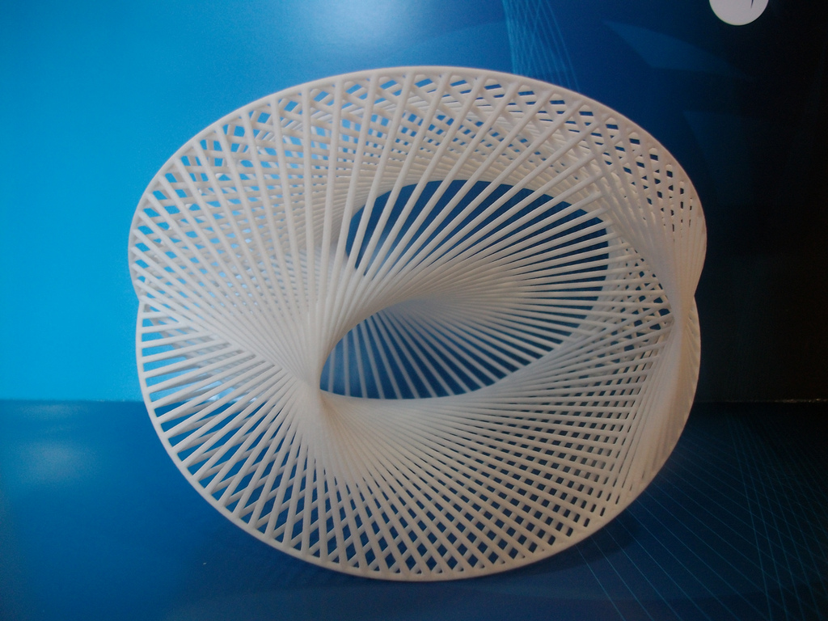
3D printed Spatial Cardioid Formlabs 3, by fdecomite.

Slide 8
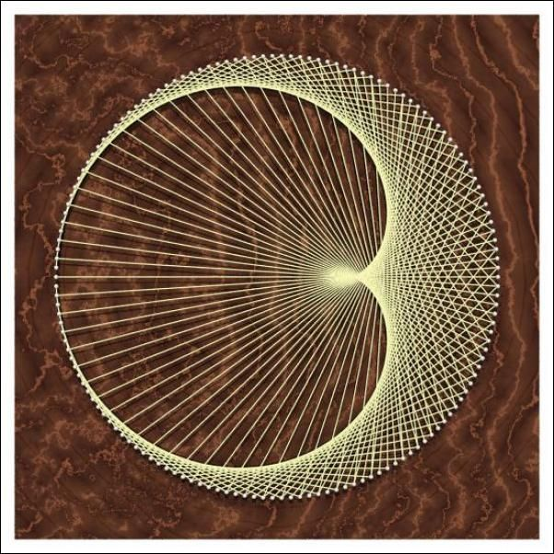
http://demonstrations.wolfram.com/GeneratingACardioidVIIJoiningPointsOnACircle/

Slide 10
n è 2n (mod 60)
2
4
6
8
10
12
14

Slide 11
n è 2n (mod 60)
2
4
6
8
10
12
14
16
18
20
22
24
26
28
30
32
34
36
38
40
42
44
46
48
50
52
54
56
58
60
2
4
6
8
10
12
14
16
18
20
22
24
26
28
30
32
34
36
38
40
42
44
46
48
50
52
54
56
58
60

Slide 13
n è 2n (mod 60)
2
4
6
8
10
12
14
16
18
20
22
24
26
28
30
32
34
36
38
40
42
44
46
48
50
52
54
56
58
60
2
4
6
8
10
12
14
16
18
20
22
24
26
28
30
32
34
36
38
40
42
44
46
48
50
52
54
56
58
60

Slide 15
n è 2n (mod 60)
2
4
6
8
10
12
14
16
18
20
22
24
26
28
30
32
34
36
38
40
42
44
46
48
50
52
54
56
58
60
2
4
6
8
10
12
14
16
18
20
22
24
26
28
30
32
34
36
38
40
42
44
46
48
50
52
54
56
58
60

Slide 17
Finished?!
Why not experiment… what happens if you map
n $→$ 3n(mod 60) or
n $→$ 4n(mod 60)?

Slide 18
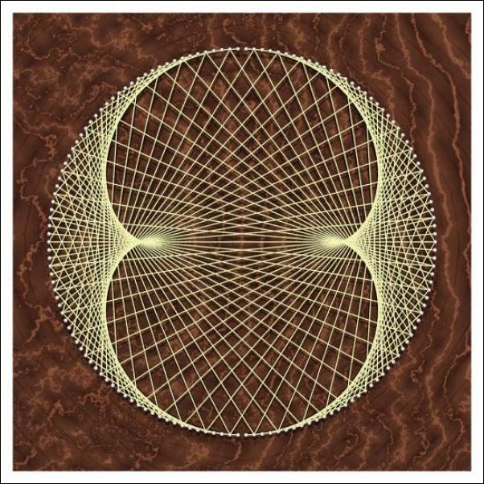
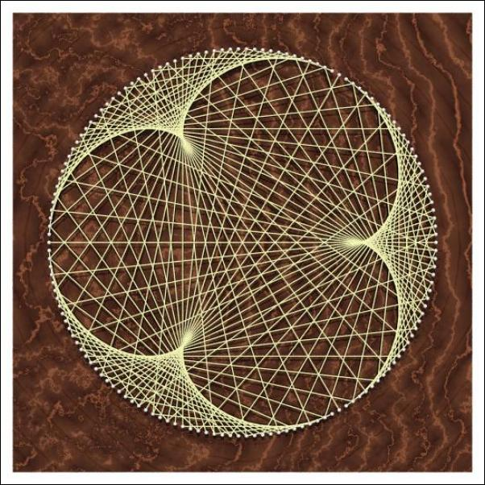
n $→$ 3n(mod 60)
n $→$ 4n(mod 60)
Nephroid
Epicycloid of Cremona

Slide 19
What happens if we carry on…?
http://www.antiprism.com/album/865_string_art/string1_1_Lrg.jpg.0.html

