Slide 1
the hyperbolic paraboloid

Slide 2
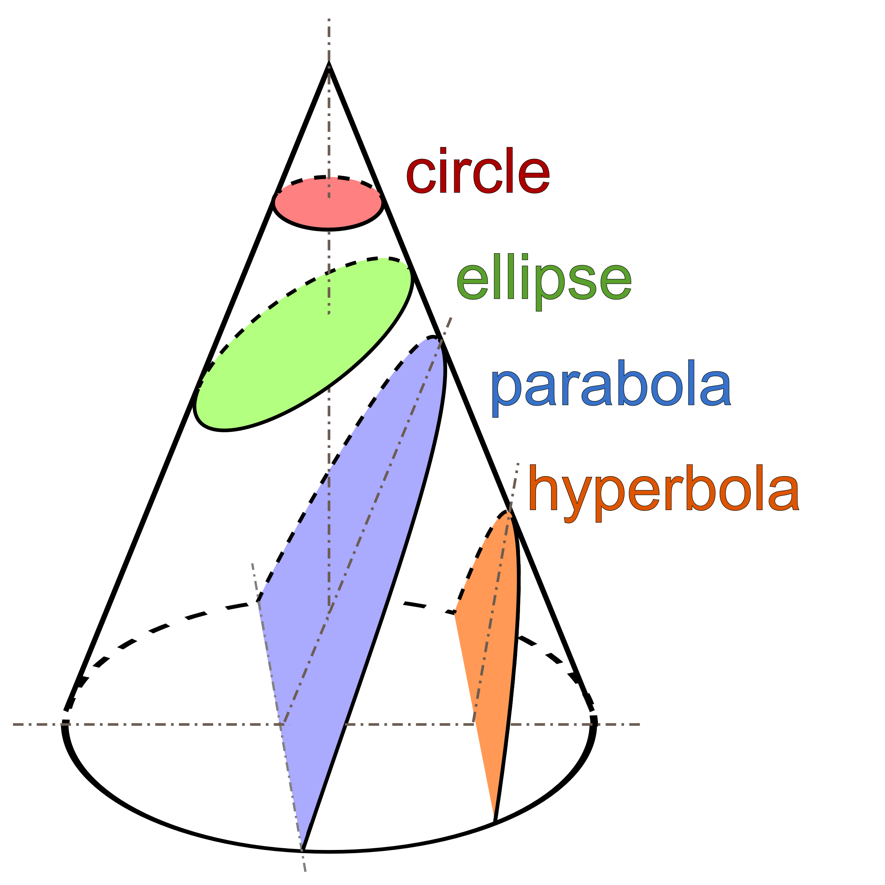
conic sections
Notes:
Conic sections image: Magister_Mathematicae, CC BY-SA 3.0 <https://creativecommons.org/licenses/by-sa/3.0>, via Wikimedia Commons

Slide 3
the mutant offspring of…
Parabola
Hyperbola
Notes:
Parabola image: Ag2gaeh, CC BY-SA 4.0 <https://creativecommons.org/licenses/by-sa/4.0>, via Wikimedia Commons
Hyperbola image: Ag2gaeh, CC BY-SA 4.0 <https://creativecommons.org/licenses/by-sa/4.0>, via Wikimedia Commons

Slide 4
Hyperbolic Paraboloid
A hyperbolic paraboloid is an infinite surface in three dimensions with hyperbolic and parabolic cross-sections
Notes:
Hyperbolic paraboloid image: Sam Derbyshire, CC BY-SA 3.0 <https://creativecommons.org/licenses/by-sa/3.0>, via Wikimedia Commons

Slide 5
hyperbolic paraboloids amongst us…

Slide 6
hyperbolic paraboloids amongst us…

Slide 7
hyperbolic paraboloids amongst us…
Notes:
Coral image: Toby Hudson, CC BY-SA 3.0 <https://creativecommons.org/licenses/by-sa/3.0>, via Wikimedia Commons
Crochet image: Dvortygirl, CC BY-SA 3.0 <https://creativecommons.org/licenses/by-sa/3.0>, via Wikimedia Commons

Slide 8
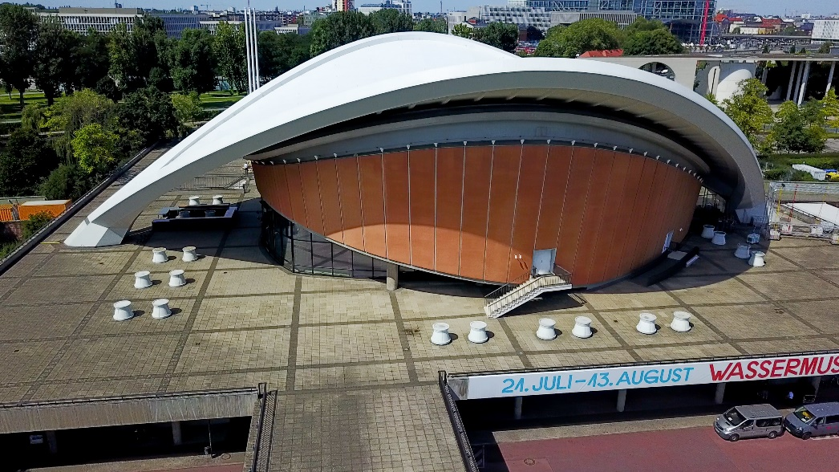
hyperbolic paraboloids amongst us…
Notes:
Images:
KK nationsonline, CC BY-SA 4.0 <https://creativecommons.org/licenses/by-sa/4.0>, via Wikimedia Commons
Felipe Gabaldón, CC BY 2.0 <https://creativecommons.org/licenses/by/2.0>, via Wikimedia Commons
Panek, CC BY-SA 4.0 <https://creativecommons.org/licenses/by-sa/4.0>, via Wikimedia Commons

Slide 9
hyperbolic paraboloids amongst us…

Slide 10
hyperbolic paraboloids amongst us…
This origami artwork, “Green Cycles” is by Erik Demaine and his father Martin.
Notes:
Credit: Renwick Gallery

Slide 11
folding the hyperbolic paraboloid
Video: https://www.youtube.com/watch?v=4g1OcLHp6yI
Printable instructions from Erik Demaine : http://erikdemaine.org/hypar/hypar_folding_150.gif
Blog post by Erik Demaine: http://erikdemaine.org/hypar/

Slide 12
the pringles challenge!
https://interestingengineering.com/geometry-of-pringles-crunchy-hyperbolic-paraboloid

Slide 13
constructing a hyperbolic paraboloid
https://mathcraft.wonderhowto.com/how-to/make-hyperbolic-paraboloid-using-skewers-0131751/

