Slide 1
Amazing mazes, Mathematical art and Origami
Personal Challenge Week

Slide 2
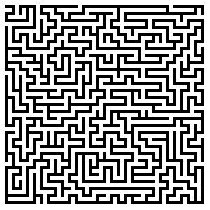
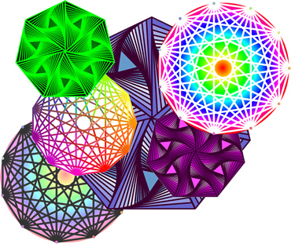
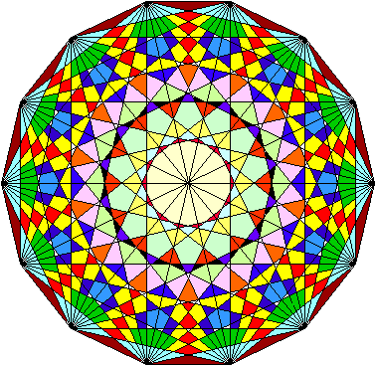
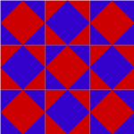
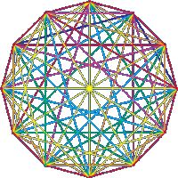
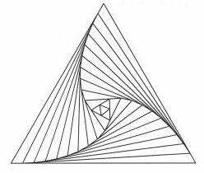
What to expect…

Slide 3
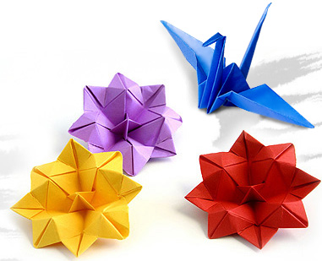
What to expect…

Slide 4
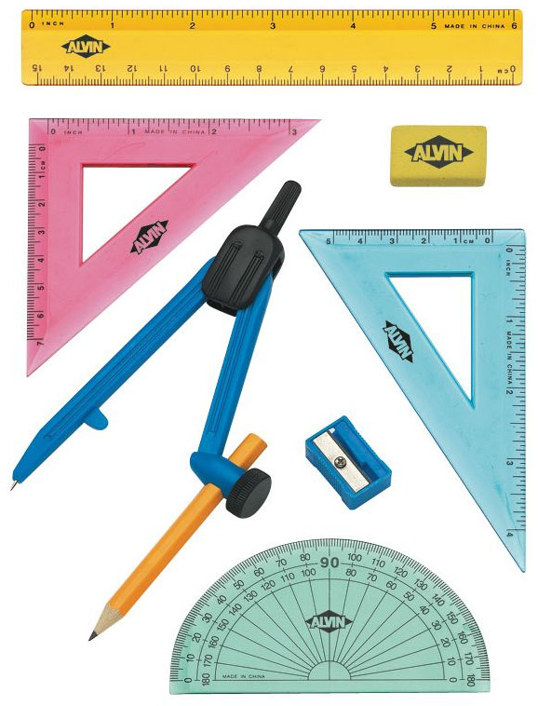
Everything you need…
is in front of you.

Slide 5
Stars of the day!
You will have the opportunity to be nominated for a certificate under the following headings:
C = Challenge
H = Having a go
A = Ability
L = Listening
L = Learning
E = Expectations
N = Nerves (overcoming them)
G = Going for it
E = Enjoyment!

Slide 6
So sharpen those pencils…
and let’s begin!
☺

