Slide 1
The predatory bugs problem….
Three predatory bugs are initially sitting at the corners of an equilateral triangle. All at once, each of the bugs begin crawling with equal speed directly toward the bug on their right.
What is the path of each bug?
Demonstration of the pursuit paths of predatory bugs:
http://www.hellam.net/pursuit.html

Slide 2
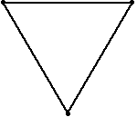

Slide 3
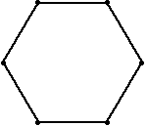
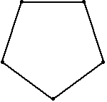
The curves made by the bugs’ tracks are called ‘whirls’.
If we plotted the bugs’ ‘sightlines’ at regular intervals, what might the results look like?
Weisstein, Eric W. "Mice Problem." From MathWorld--A Wolfram Web Resource. http://mathworld.wolfram.com/MiceProblem.html

Slide 4
Source: Daniel Walsh

Slide 5
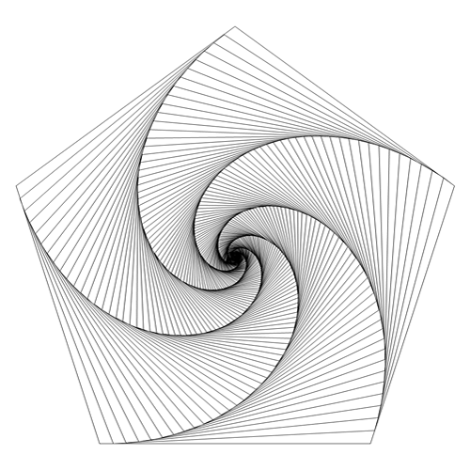
Curves of Pursuit
Source: Devan Matthews, Excelmathart, Tumblr

Slide 6
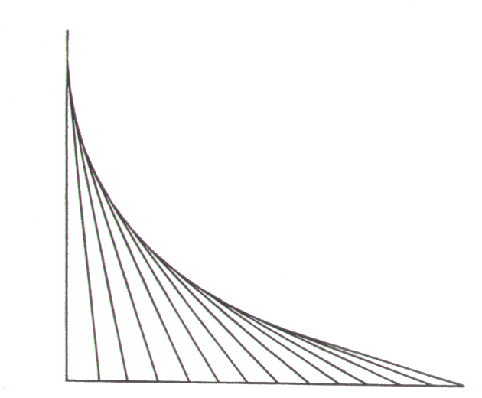

Slide 7
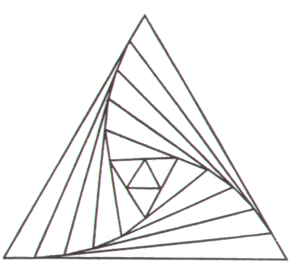

Slide 8
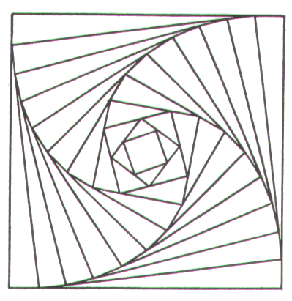

Slide 9
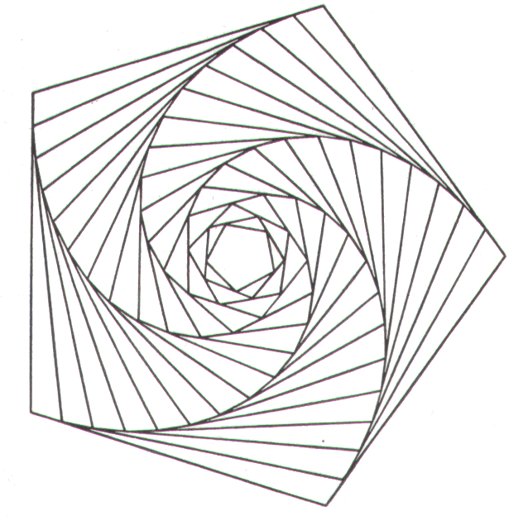

Slide 10
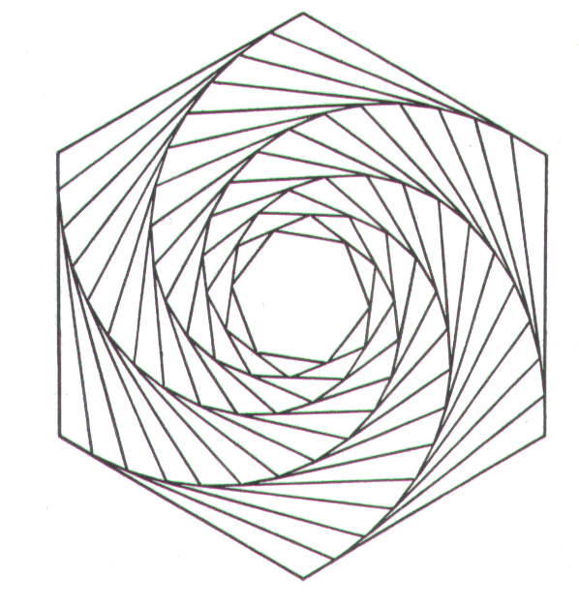

Slide 11
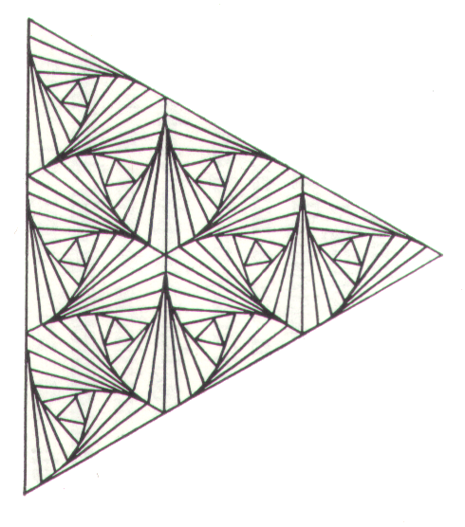
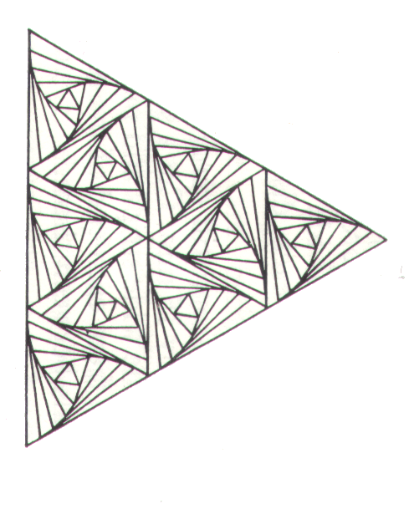

Slide 12
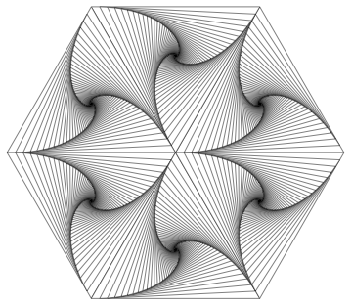
Source: Daniel Walsh

Slide 13
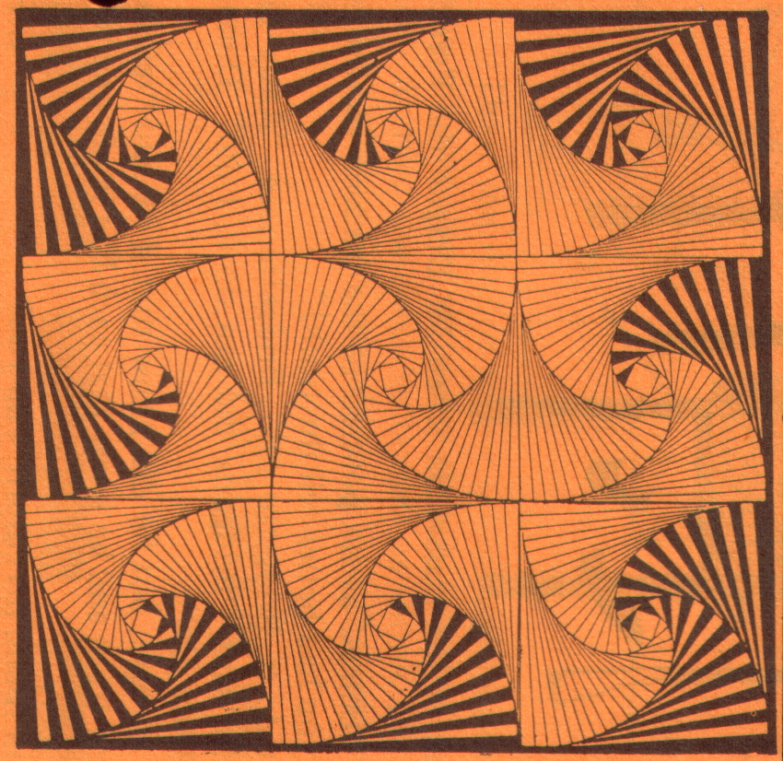
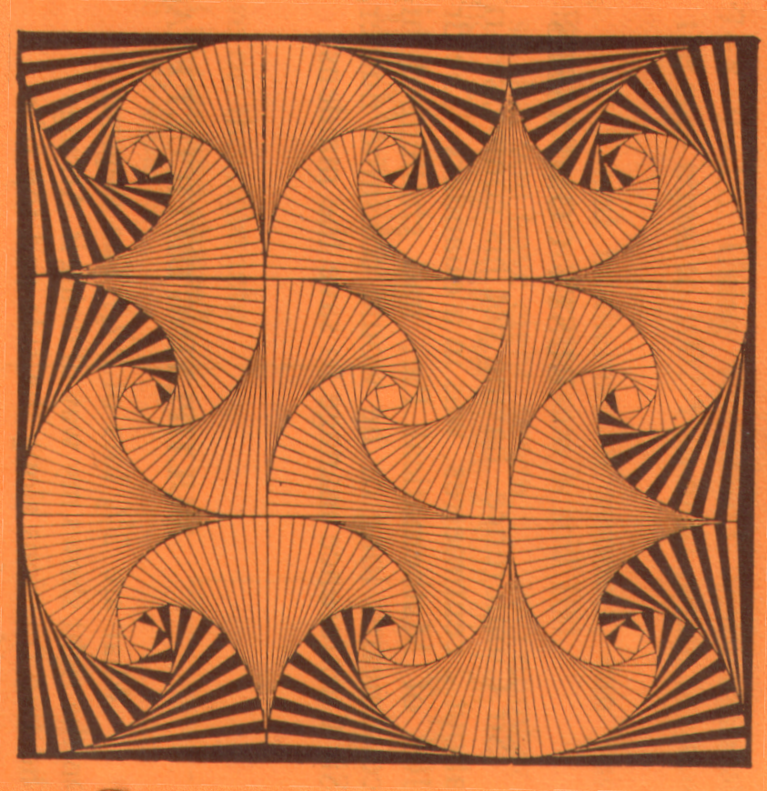
Source unknown

Slide 14
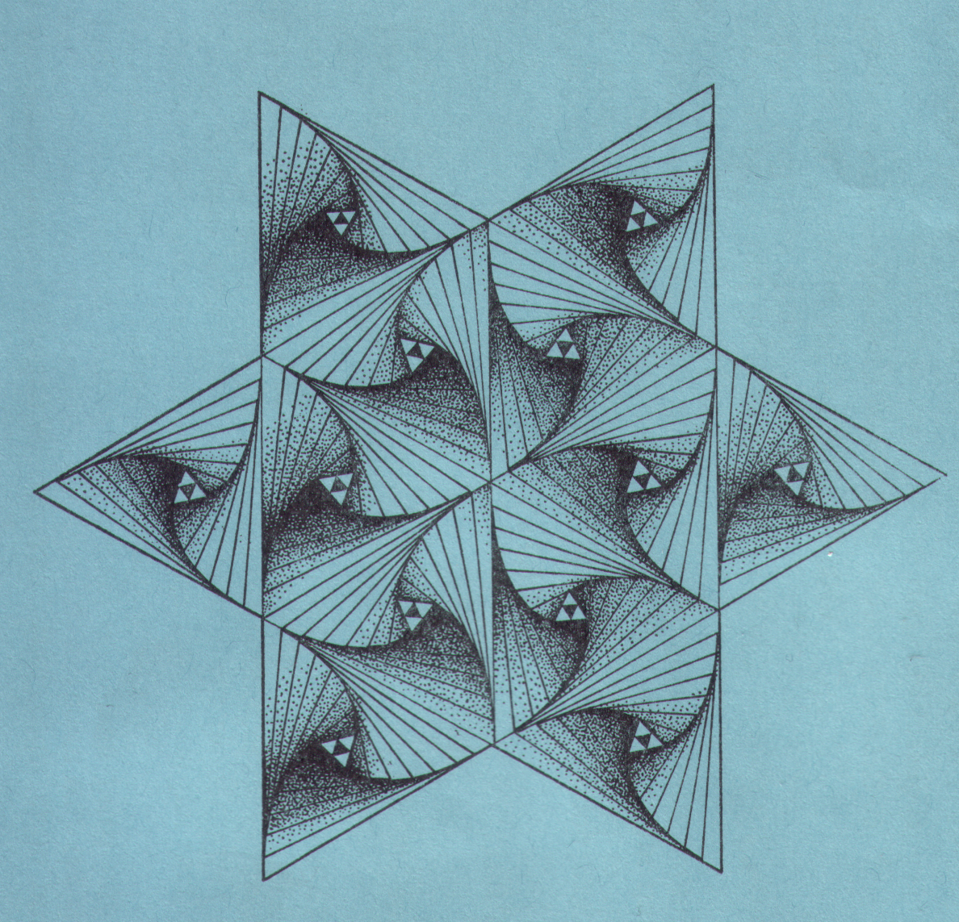
Source unknown

Slide 15
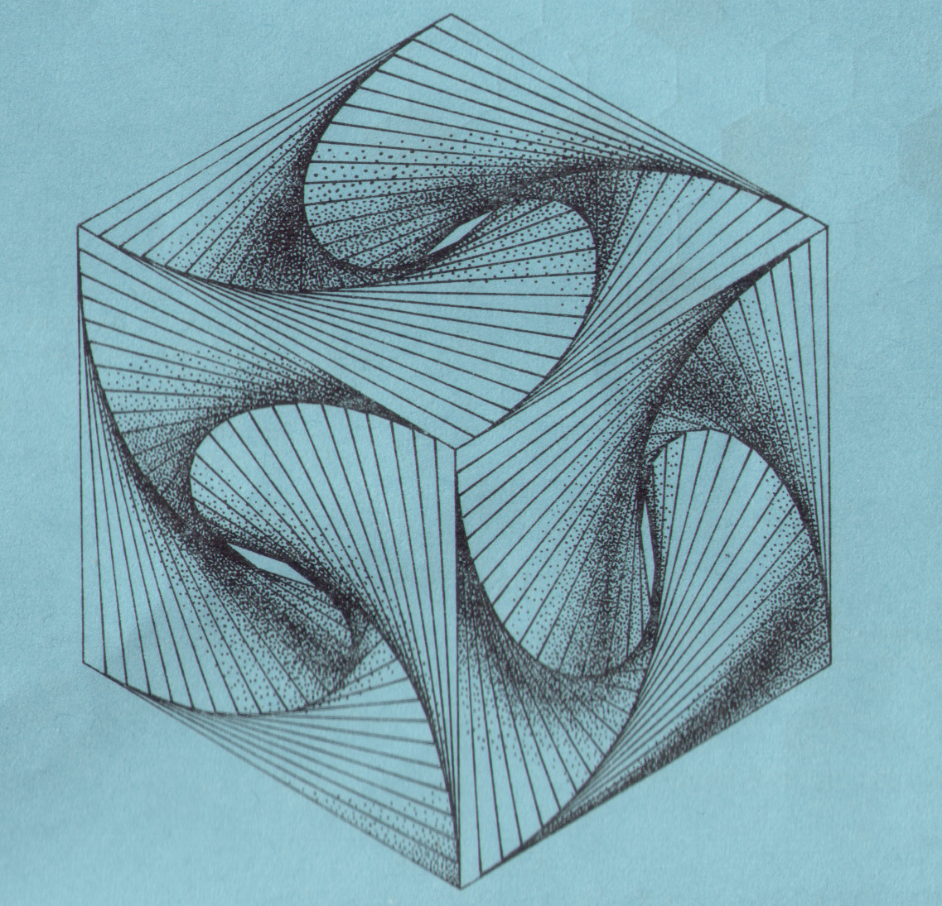
Source unknown

Slide 16
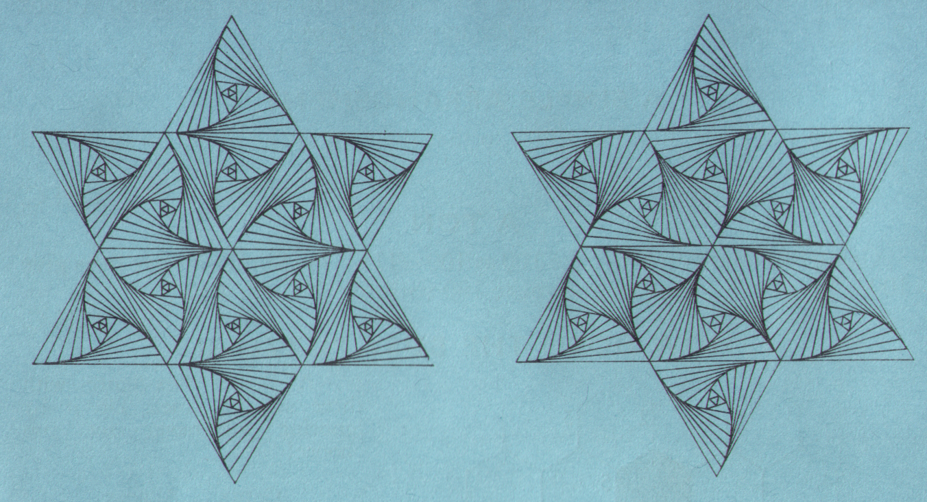
Source unknown

Slide 17
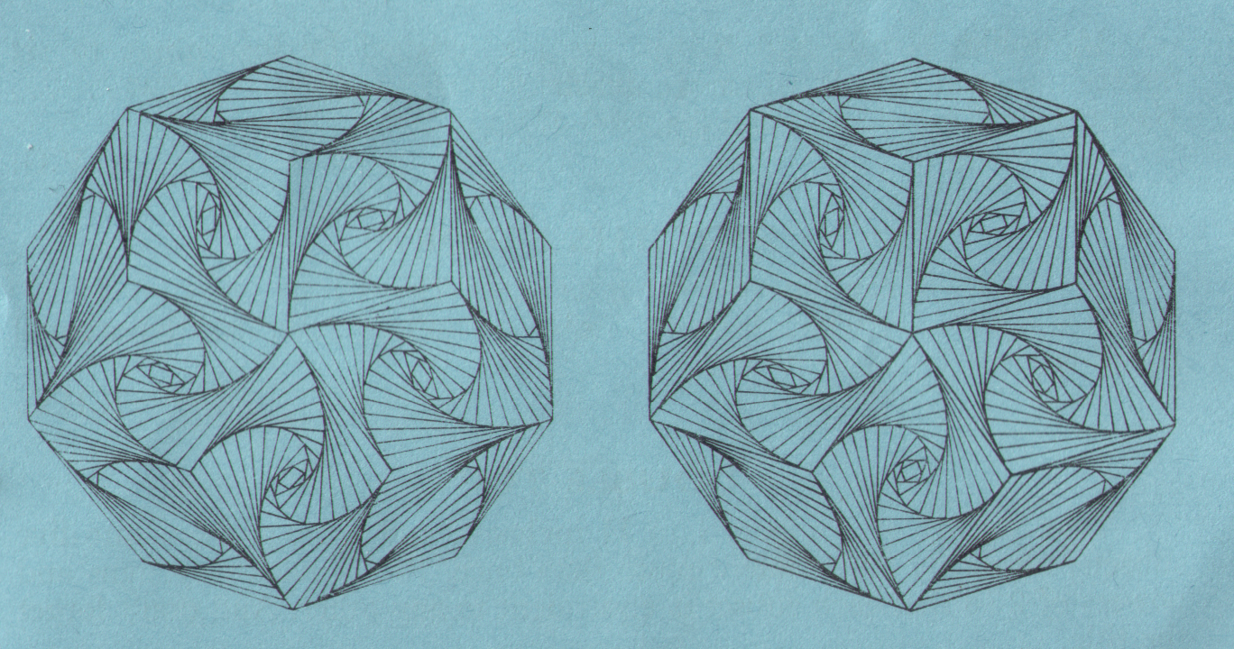
Source unknown

Slide 18
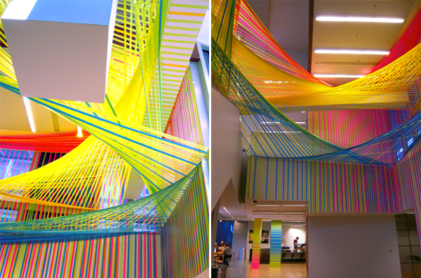
Tape Installation at the Wexner Centre for the Arts, by Megan Geckler

Slide 19
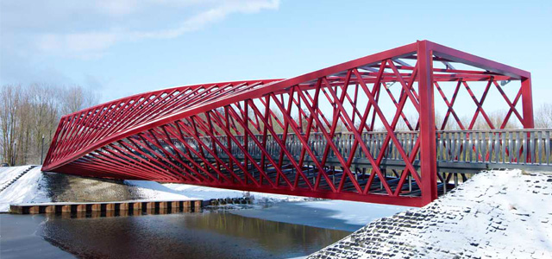
Twisted bridge, Vlaardingen, Netherlands

Slide 20
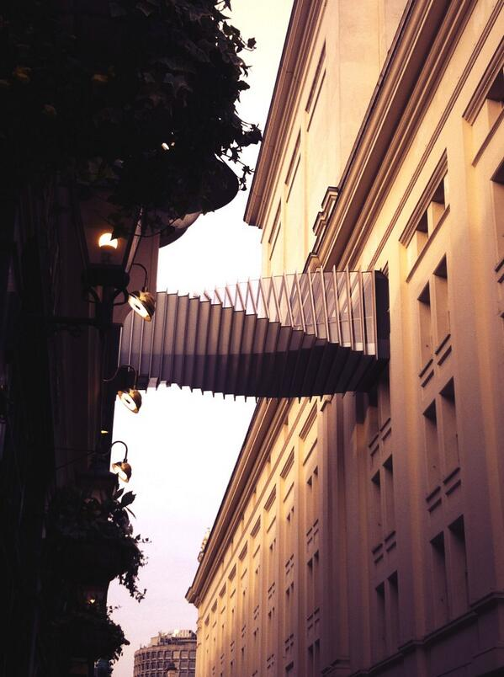
Bridge of Aspirations, Floral Street, London. Photo: Clarissa Grandi

Slide 21
High Trestle Trail Bridge, Iowa. Photo by Tony Webster

Slide 22
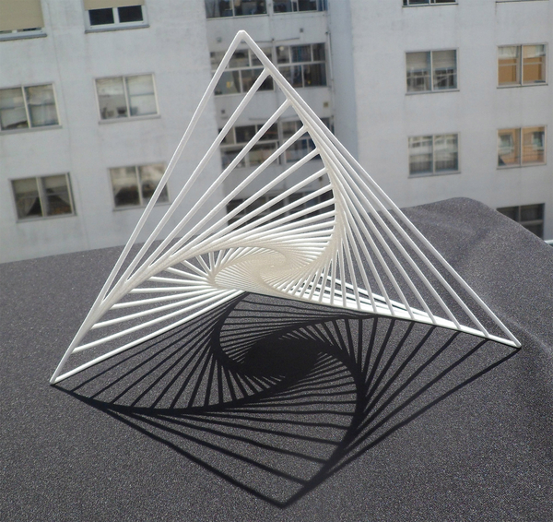
“Logo”, 3D printed artwork by Manuel Diaz Regueiro

Slide 23
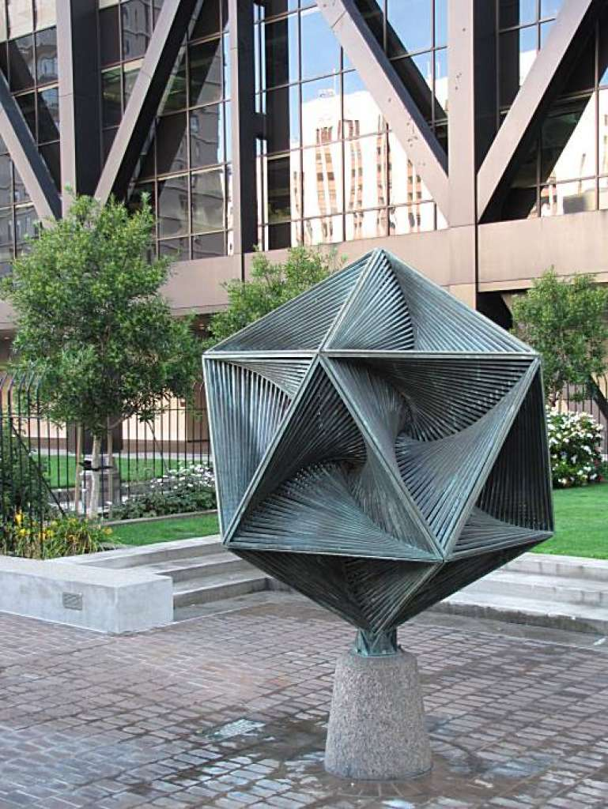
Icosaspirale, by Charles Perry. Photo by John King

Slide 24
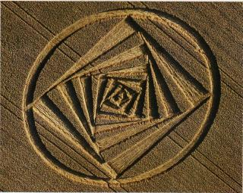
Even aliens know about them!
Curve of pursuit crop circle. Desenberg, Germany August 2001

Slide 25
Start by drawing a regular polygon.
Make 4 small marks the same distance in from each side...

Slide 26
then join the marks up...

Slide 27
then join the marks up...

Slide 28
then join the marks up...

Slide 29
then join the marks up...
to make a smaller polygon within the larger one.

Slide 30
And again, make 4 small marks the same distance from each side of the new polygon...

Slide 31
and join the marks up...

Slide 32
and join the marks up...

Slide 33
and join the marks up...

Slide 34
and join the marks up...
to make a smaller polygon within the larger one.

Slide 35
And again, four small marks...

Slide 36
join them up...

Slide 37
join them up...

Slide 38
and on and on....

Slide 40
Constructing a hexagon
Think, pair, share:
How can you construct a regular hexagon from a circle using only a pair of compasses?
30 secs to think
1 min to discuss in a pair
Then we’ll share

Slide 41
Constructing a hexagon
Start by drawing a circle

Slide 42
Constructing a hexagon
Mark the centre faintly

Slide 43
Constructing a hexagon
Draw in a faint radius

Slide 44
Constructing a hexagon
With your compasses, draw an arc the same length as the radius

Slide 45
Constructing a hexagon
And another ...

Slide 46
Constructing a hexagon
And another ...

Slide 47
Constructing a hexagon
And another ...

Slide 48
Constructing a hexagon
And one more

Slide 49
Constructing a hexagon
Join up the points to create the hexagon

Slide 50
Constructing a hexagon
Why does this method produce a regular hexagon?

Slide 51
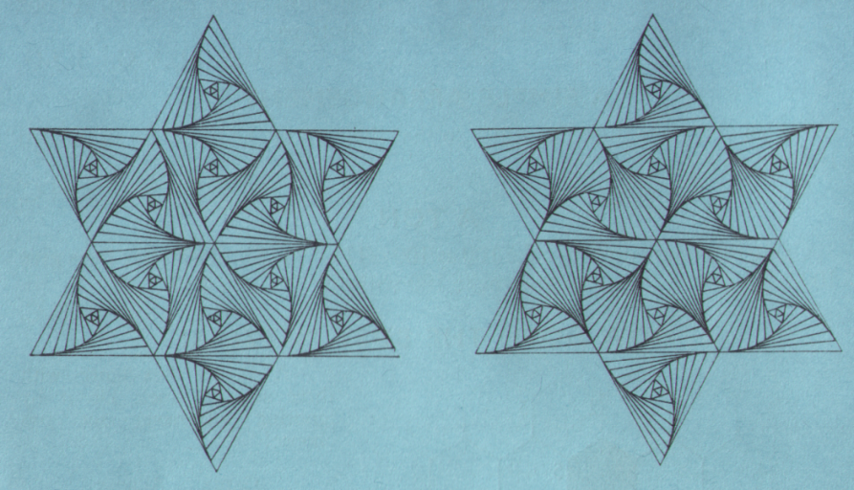
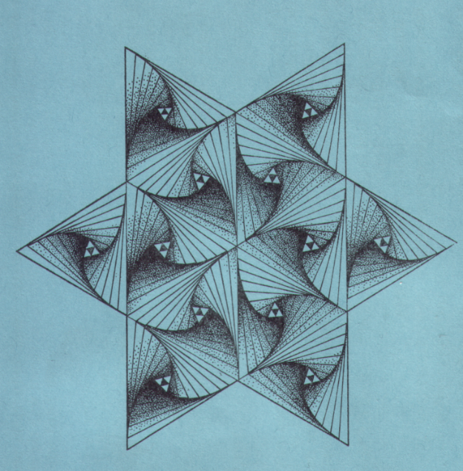
Time to experiment with hexagons!

